Slide 1

U204206B-Digital Electronics– Spring 2022

Slide 2
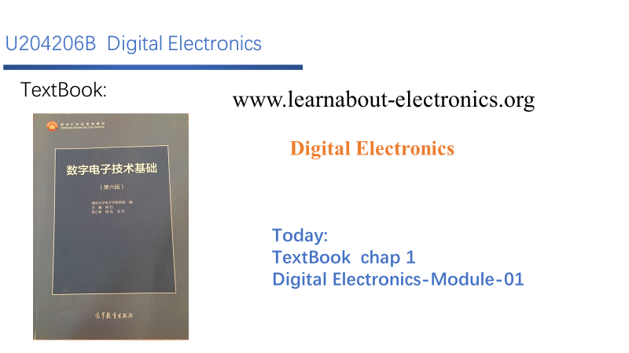

Slide 3
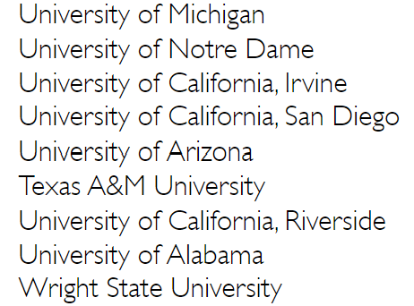

Digital Design
Chapter 1:
Introduction
Slides to accompany the textbook Digital Design, First Edition, by Frank Vahid, John Wiley and Sons Publishers, 2007. http://www.ddvahid.com
Copyright © 2007 Frank Vahid
Instructors of courses requiring Vahid's Digital Design textbook (published by John Wiley and Sons) have permission to modify and use these slides for customary course-related activities, subject to keeping this copyright notice in place and unmodified. These slides may be posted as unanimated pdf versions on publicly-accessible course websites.. PowerPoint source (or pdf with animations) may not be posted to publicly-accessible websites, but may be posted for students on internal protected sites or distributed directly to students by other electronic means. Instructors may make printouts of the slides available to students for a reasonable photocopying charge, without incurring royalties. Any other use requires explicit permission. Instructors
may obtain PowerPoint source or obtain special use permissions from Wiley – see http://www.ddvahid.com for information.
2
Notes:
1密歇根大学，2圣母大学 3加州大学尔湾分校4加州大学圣地亚哥分校5亚利桑那大学6德州农工大学7加州大学河滨分校8阿拉巴马大学9莱特州立大学

Slide 4

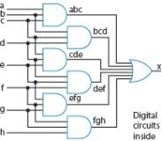
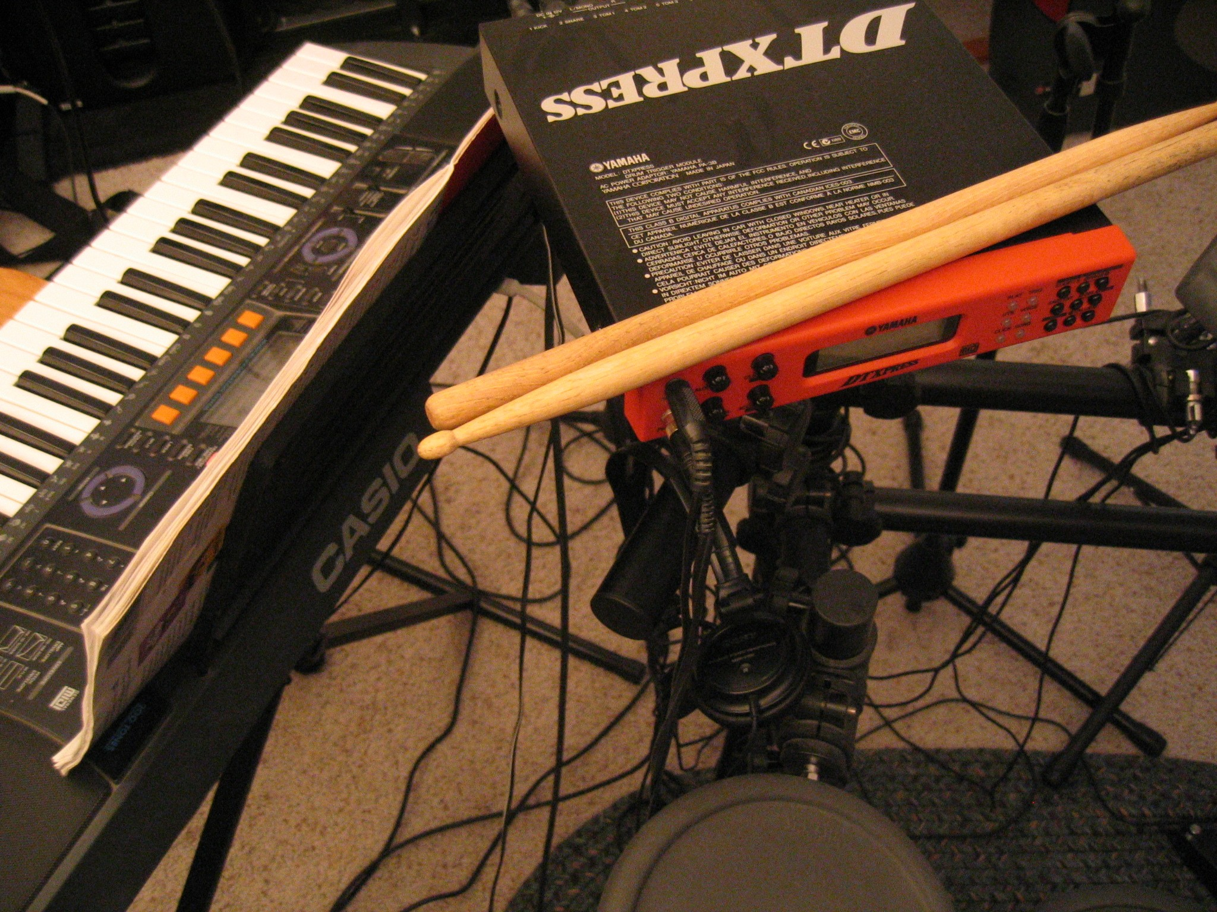

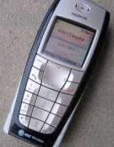
Digital Logic – Introduction
Why Study Digital Design?
1.1
Look “under the hood” of computers
Solid understanding --> confidence, insight, even better programmer when aware of hardware resource issues
Electronic devices becoming digital
Enabled by shrinking and more capable chips
Enables:
Better devices: Better sound recorders, cameras, cars, cell phones, medical devices,...
New devices: Video games, PDAs, ...
Known as “embedded systems”
Thousands of new devices every year
Designers needed: Potential career direction
Satellites
DVD
players
Video recorders
Musical instruments
???
Portable
music players Cell phones Cameras
TVs
1995 1997 1999 2001 2003 2005 2007
Years shown above indicate when digital version began to dominate
– (Not the first year that a digital version appeared)
3

Slide 5

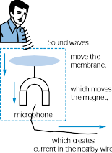
Digital Logic – Introduction
What Does “Digital” Mean?
1.2
Analog signal
Infinite possible values
Ex: voltage on a wire created by microphone
Digital signal
Finite possible values
Ex: button pressed on a keypad
1 2 3 4
 | ² digital signal
analog signal
Possible values:
1.00, 1.01, 2.0000009,
... infinite possibilities
Possible values: 0, 1, 2, 3, or 4.
That’s it.
value
value
4
3
2
1
0
time
time
4

Slide 6
Digital Logic – Introduction
Binary - Digital Signals with Only Two Values
Binary digital signal -- only two
possible values
Typically represented as 0 and 1
One binary digit is a bit
We’ll only consider binary digital signals
Binary is popular because
Transistors, the basic digital electric component, operate using two voltages
Storing/transmitting one of two values is easier than three or more (e.g., loud beep or quiet beep, reflection or no reflection)
value
1
0
time
5

Slide 7

Digital Logic – Introduction
Example of Digitization
Analog signal (e.g., audio) may lose quality
Voltage levels not saved/ copied/transmitted perfectly
Digitized version enables near-perfect save/cpy/trn.
“Sample” voltage at particular rate, save sample using bit encoding
Voltage levels still not kept perfectly
But we can distinguish 0s from 1s
Let bit encoding be:
Volts
3
2
1
0
lengthy transmission lengthy transmission (e.g, cell phone) (e.g, cell phone)
3
2
original signal
1 received signal
0
time
time
How fix -- higher, lower, ?
01 10 11 10 11
a2d
Volts
a
₁ digitized signal
1
0
0
time
time
Can fix -- easily distinguish 0s and 1s, restore
01 10 11 10 11
1 V: “01”
2 V: “10”
3 V: “11”
Digitized signal not perfect re-creation,
d2a
same
Volts
3
but higher sampling rate and more bits per encoding brings closer.
2
1
0
time
6

Slide 8
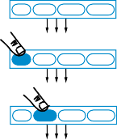
Digital Logic – Introduction
How Do We Encode Data as Binary for Our Digital System?
analog phenomena
button
a
Some inputs inherently binary
Button: not pressed (0), pressed (1)
Some inputs inherently digital
Just need encoding in binary
e.g., multi-button input: encode red=001, blue=010, ...
Some inputs analog
Need analog-to-digital conversion
As done in earlier slide -- sample and encode with bits
0
1
sensors and other inputs
red blue green black
electric signal
digital data
0 0 0
A2D
red blue green black
digital data
0 0 1
Digital System
red blue green black
digital data
digital data
0 1 0
air
D2A
33
degrees
electric signal
temperature sensor
actuators and other outputs
0 0 1 0 0 0 0 1
7

Slide 9
Digital Logic – Introduction
How to Encode Numbers: Binary Numbers
Each position represents a quantity; symbol in position means how many of that quantity
Base ten (decimal)
Ten symbols: 0, 1, 2, ..., 8, and 9
More than 9 -- next position
So each position power of 10
Nothing special about base 10 -- used because we have 10 fingers
Base two (binary)
Two symbols: 0 and 1
More than 1 -- next position
So each position power of 2
5 2 3
10⁴ 10³ 10² 10¹ 10⁰
1 0 1
₂4 ₂3 ₂2 ₂1 ₂0
8

Slide 10
Digital Logic – Introduction
How to Encode Numbers: Binary Numbers
Working with binary numbers
In base ten, helps to know powers of 10
one, ten, hundred, thousand, ten thousand, ...
In base two, helps to know powers of 2
one, two, four, eight, sixteen, thirty two, sixty four, one hundred twenty eight
□ (Note: unlike base ten, we don’t have common names, like “thousand,” for each position in base ten -- so we use the base ten name)
10³ 10² 10¹ 10⁰
1000 100 10 1
₂9 ₂8 ₂7 ₂6 ₂5 |  | ₂4 ₂3 | ₂2 | ₂1 | ₂0
512 256 128 64 32 |  | 16 8 | 4 | 2 | 1
9

Slide 11

Digital Logic – Introduction
Converting from Decimal to Binary
What is the value of the binary number 100110 in decimal?
1. 100,110
2. 21
3. 22
4. 38
10

Slide 12
Digital Logic – Introduction
Converting from Decimal to Binary Numbers
Subtraction Method (Easy for Humans)
Goal: Get the binary weights to add up to the decimal quantity
Work from left to right
(Right to left – may fill in 1s that shouldn’t have been there – try it). Subtraction method
Subtract a selected binary weight from the (remaining) quantity
Then, we have a new remaining quantity, and we start again (from the present binary position)
Stop when remaining quantity is 0
Remaining quantity: 12
32 16 8 4 2 1
1
32 16 8 4 2 1
32 is too much
0 1
32 16 8 4 2 1
16 is too much
a
₀ ₀ ₁ 12 – 8 = 4
32 16 8 4 2 1
0 0 1 1
32 16 8 4 2 1
4-4=0
DONE
0 0 1 1 0 0
32 16 8 4 2 1
answer
11

Slide 13

Digital Logic – Introduction
Converting from Decimal to Binary
What is the value of the decimal number 25 in binary?
1. 11000
2. 11001
3. 10111
4. 011001
12

Slide 14
Digital Logic – Introduction
Converting from Decimal to Binary
Division Method (Good for Computers)
Divide decimal number by 2 and insert remainder into new binary number.
Continue dividing quotient by 2 until the quotient is 0.
Example: Convert decimal number 12 to binary
Decimal Number
Binary Number
0
1
6
2 12 divide by 2
-12
0
insert remainder
Continue dividing since quotient (6) is greater than 0
3
0 0
2 6 divide by 2
-6
2 1
0
insert remainder
Continue dividing since quotient (3) is greater than 0
13

Slide 15
Digital Logic – Introduction
Converting from Decimal to Binary
Example: Convert decimal number 12 to binary (continued)
Decimal Number
1
2 3 divide by 2
-2
Binary Number
1 0 0
4 2 1
1
insert remainder
Continue dividing since quotient (1) is greater than 0
0
1 1 0 0
8 4 2 1
2 1 divide by 2
-0
1
insert remainder
Since quotient is 0, we can conclude that 12 is 1100 in binary
14

Slide 16

Digital Logic – Introduction
Converting from Decimal to Binary
What is the value of the decimal number 54 in binary?
1. 110110
2. 100010
3. 1000010
4. None of the above
15

Slide 17
Digital Logic – Introduction
Hexadecimal Numbers
8 A F
16⁴ 16³ 16² 16¹ 16⁰
8 A F
Nice because each position represents four base two positions
□ Used as compact means to write binary numbers
Known as hexadecimal, or just hex
1000 1010 1111
hex | bina ry
0 | 0000
1 | 0001
2 | 0010
3 | 0011
4 | 0100
5 | 0101
6 | 0110
7 | 0111
hex | bina ry
8 | 1000
9 | 1001
A | 1010
B | 1011
C | 1100
D | 1101
E | 1110
F | 1111
Convert 11110000 to hex:
F 0
a
16

Slide 18

Digital Logic – Introduction
Converting from Hexadecimal to Binary
What is the value of the hexadecimal number AB in binary?
1. 10111010
2. 01011011
3. 10101011
4. 10101010
hex | bina ry
0 | 0000
1 | 0001
2 | 0010
3 | 0011
4 | 0100
5 | 0101
6 | 0110
7 | 0111
hex | bina ry
8 | 1000
9 | 1001
A | 1010
B | 1011
C | 1100
D | 1101
E | 1110
F | 1111
17

Slide 19

Digital Logic – Introduction
Converting from Hexadecimal to Decimal
What is the value of the hexadecimal number 2E in decimal?
1. 101110
2. 00101110
3. 30
4. 46
hex | bina ry
0 | 0000
1 | 0001
2 | 0010
3 | 0011
4 | 0100
5 | 0101
6 | 0110
7 | 0111
hex | bina ry
8 | 1000
9 | 1001
A | 1010
B | 1011
C | 1100
D | 1101
E | 1110
F | 1111
18

Slide 20
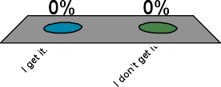
Digital Logic – Introduction
An attempt at humor
There are 10 types of people in the world: Those who get binary and those who don’t. Which type are you?
1. I get it.
2. I don’t get it.
19

